Slide 1
Fifa World cup Analysis
BY:- ABHI SAHU

Slide 2
Problem Statement
The FIFA World Cup is a global football competition contested by the various football-playing
nations of the world. It is contested every four years and is the most prestigious and important
trophy in the sport of football.
Find key metrics and factors that influence the World Cup Win.

Slide 3
Details of Data
Data from 3 different files was taken for Analysis.
The first Table WorldCupMatches contains around 20 columns of different dataset Ex. Home Team Goals, Away Team Goals, Away Team Name, Win conditions, Attendance, RoundID, MatchID etc.
The second table WorldCupPlayers contains around 10 columns of different dataset Ex. RoundID, MatchID, Team Initials Coach Name,Player Name, Position etc.
The third table WorldCups contains around 10 columns of different dataset Ex. Year, Country, Winner, Runners-Up, Third, Fourth, GoalsScored, QualifiedTeams, Attendance etc.

Slide 4
Main KPIs
Team Performance
Qualified Teams
Goals Scored
World Cup Years
Tools Used for Analysis are – Excel and Power Bi
LINK Power Bi Template :- https://drive.google.com/file/d/1xMg3RsV01VX_ACeIttsI9TWZu57dMxpP/view?usp=drive_link
Pdf :- https://drive.google.com/file/d/1xMg3RsV01VX_ACeIttsI9TWZu57dMxpP/view?usp=drive_link

Slide 5
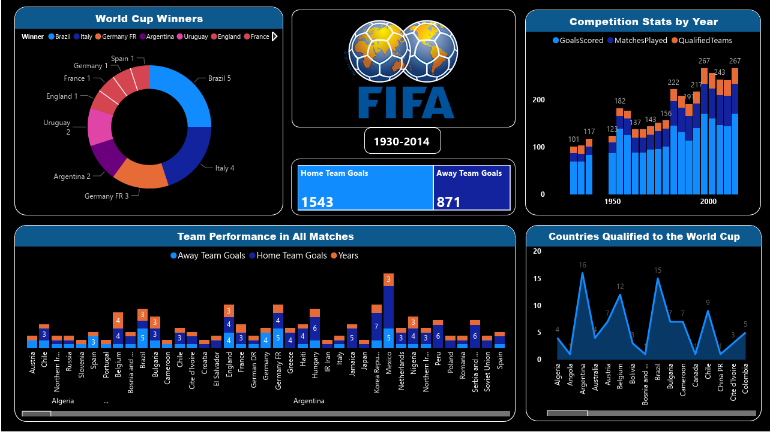
My Design

Slide 6
Thank You

